Slide 1
SMS 9-1-1 New Jersey NENA Fall Meeting
November 22, 2013

Slide 2
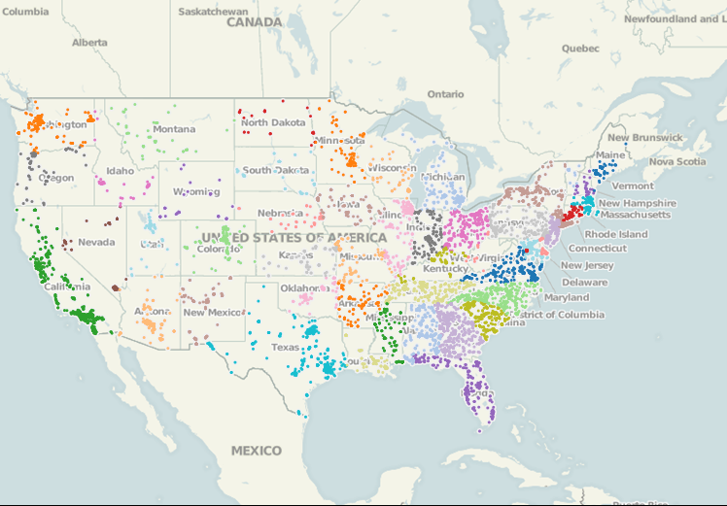
SMS 9-1-1 Attempts for One Carrier
> 71,000 Public SMS 9-1-1 Attempts 1/1/13 – 9/30/13

Slide 3
SMS 9-1-1 Progress To Date
52 PSAPs in 16 states
36 use TCS GEM9-1-1 Web Portal
6 use TTY
10 Steering to Intrado
28 Public Announcements
More Announcements Soon
20 PSAPs in Process of Being Deployed
More Than 150 PSAPs in Queue
T-Mobile FOA Later This Month!
Notes:
Flexible and Robust Solution
Multiple Delivery Options to the Public Safety Answering Point (PSAP)
Real-Life Deployment Experience
PSAP On-Boarding
Carrier On-Boarding
Willing and Able to Support California’s Pilot and Production Needs
Recommend Three Pilots
Two Varieties of TTY
Web Services Interface (GEM911™)

Slide 4
Deployment Options
GEM 9-1-1™ Web Interface
TTY
Direct IP – i3 Interface (MSRP)

Slide 5
Anything Unexpected?
PSAPs need to have 24X7 control of their Internet access.
Web interface training is easier and faster than expected.
Location will vary among carriers.

Slide 6
How’s it going?
Like wireless 9-1-1, SMS 9-1-1 is being deployed in a variety of ways:
State level, County level, PSAP level
States are beginning to see the need to avoid fragmentation
California
Florida
New Jersey
Maryland
Will texts from all carriers look the same?

Slide 7
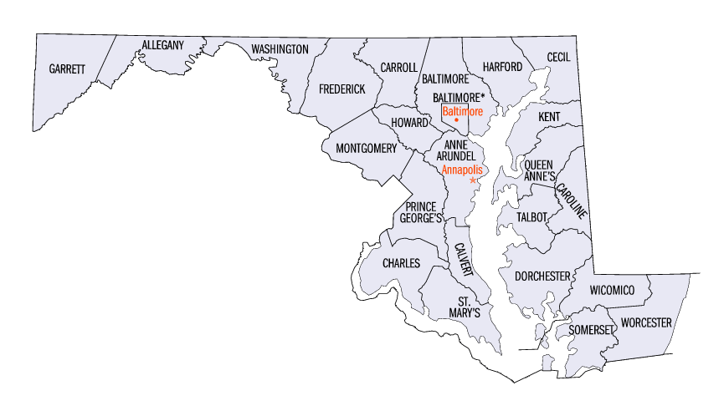
The Argument for Statewide Deployment

Slide 8
The Argument for Statewide Deployment
Verizon Wireless Only
All Wireless Carriers
A Subset of All Carriers

Slide 9
A Controlled SMS 9-1-1 Deployment
All Wireless Carriers

Slide 10
Benefits
Uniformity
Wireless Carrier Coverage
Interfaces Between PSAPs and Carriers
User Experience at the PSAP
Aggregation
Reporting at the State and PSAP Levels
Single Interface to PSAP
“One-Throat-Choke” – No Need for the PSAP to Decipher Message in Order to Troubleshoot…..Just Call TCS
Consistent and Ubiquitous Service to the Residents of Maryland

Slide 11
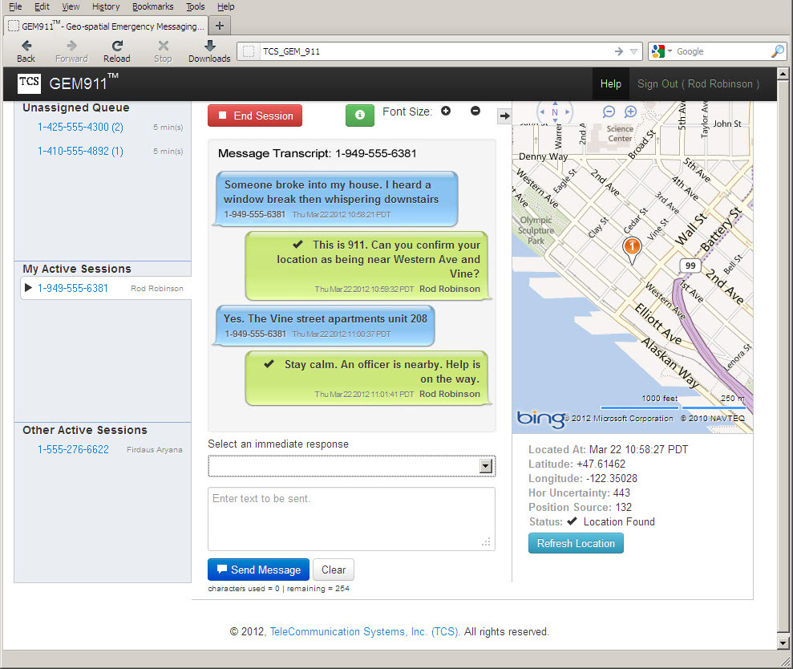
TCS GEM911 User Interface
New Incoming Messages
HUNC is Graphically Represented by the Size of the Circle
Active Sessions
Other Call Takers’ Sessions
The MDN and the Call Taker’s Username Are Shown in Each Message Next to the Timestamp
LAT/LON and HUNC Values
Drop-down With Canned Responses, or Free Type
Rebid Functionality
Transfer
PSAP: XYZ County

Slide 12
Smart911: Integrated Subscriber Info
Smart911 Fully Integrated into GEM911 Portal
Also Offer Standard Smart911
Delivery of Rich Media to PSAP
Medical Conditions
Allergies
Disabilities
Number of Residents in Home
Bedroom Layouts in Home
Photos of Dependents, Pets, Residence

Slide 13
GEM911 versus TTY
GEM911
Full Character Set
Bi-Directional Session Management (Full-Duplex)
Location Delivered with Session
Multi-Session Management
Short Deployment Timeline
Additional Data Integration
CPE Integration
IP Network Accessibility Considerations
Screen Real Estate Impact
Seamless Migration to NG9-1-1
TTY
Reduced Character Set
Uni-Directional Session Management (Half-Duplex)
Existing Automatic Location Identifier (ALI) Process for Location
Single-Session Management
Longer Deployment Timeline
Possible Cost Impacts
CPE Integration - Logging and Reporting
Reuses Existing Overload Trunking Policy
Operational Familiarity

Slide 14
SMS 9-1-1 PSAP Deployment Process
Pre-Deployment
PSAPs/State Request SMS 9-1-1 Service From Wireless Carriers
PSAPs Fill Out Checklist to Ensure Technical Readiness
Deployment
Hold Kick-Off and Project Status Calls
Provision PSAP Details
Provision PSAP Boundaries
Conduct PSAP Training
Perform Testing and Turn-up
Support
24x7 Maintenance and Troubleshooting
TL 9000-Certified Network Operations Center

Slide 15
Current TCC Deployment Architecture
Legacy PSAP (TTY)
Transitional PSAP (GEM)
Text
Control
Center
Next Generation
PSAP (i3 MSRP)
Carriers
PSAPs
Notes:
Robin
Deployments of SMS to 9-1-1 by the carrier are not linked to PSAP deployment timelines
Carriers deploy market by market, & national rollout
PSAP deployment by State / County / Jurisdiction / PSAP based individual plans by request
Matched geographic deployment requires a high level of coordination with timing & resource issues.
ATIS J-STD-110 promotes a standards based architecture
TCC deployed by the carrier toward the PSAP must support
3 types of downstream messaging
TTY
Web Services (HTTPS Client/Server)
i3 ESInet
Individual links (x2 if redundant) = to number of PSAPs

Slide 16
Multiple Service Provider Challenge
TCC 1
Legacy PSAP
TCC 2
Transitional PSAP
TCC 3
Next Generation
PSAP
TCC 4
Carriers
PSAPs
Notes:
Robin
ATIS J-STD-110 Supports Origination Provider TCC
Requirement for each carrier to operate or integrate with a TCC
Examples show single TCC architecture
Network design challenges with a single TCC
Carrier operated TCC leads to a large number of direct PSAP links
Jurisdiction operated TCC doesn’t work
Repeated Deployments – Continuous carrier integration required as PSAPs all over the US request SMS to 9-1-1 service
Requires re-integration at each PSAP for each new carrier that brings up SMS to 9-1-1 service
Numbers of circuit connections to all 6000+ PSAPs becomes immensely staggering - an exercise in circuit multiplication

Slide 17
EMedia Architecture – Interconnectivity Solution
Legacy PSAP
TTY
TCC
EMedia
GW
Transitional PSAP
SIP
HTTPS
TCC 2
SIP
Next Generation
PSAP
TCC 3
Carriers
State
PSAPs
Notes:
TCS proposes “symmetric” TCC architecture
TCS introduces EMInet, a combination messaging architecture that merges specifically defined TCC functions
EMedia Aggregation Gateway
EMedia Distribution Server
Carrier TCC and PSAP TCC work together for efficiency
EMedia Aggregation Gateway is a carrier operated TCC that handles incoming SMS messages
EMedia Distribution Server is a PSAP operated TCC that delivers text messages over the appropriate protocol to the PSAP
EMedia elements inter-communicate using standard SIP/MSRP
Reduces deployment hassles
Carrier deployment of EMedia Aggregation Gateway integrates directly with one or more regionally deployed EMedia Distribution Server(s)
Reduces interconnection (circuit) costs

Slide 20
Questions?

Slide 21
Thank you!

Slide 22
Acronyms
Acronym | Definition
ALI | Automatic Location Identifier
CPE | Customer Premise Equipment
DB | Database
ECaTS | Emergency Call Tracking System
EMInet | Emergency Media Internet Protocol Network
ESInet | Emergency Services Internet Protocol Network
ESRK | Emergency Services Routing Key
FCC | Federal Communications Commission
HTTPS | Secure Hypertext Transfer Protocol
HUNC | Horizontal Uncertainty
IP | Internet Protocol
LAT/LON | Latitude, Longitude
LSRG | Legacy Selective Router Gateway
MDN | Mobile Directory Number
MF | Multi-Frequency
MIS | Management Information System
Acronym | Definition
MSC | Mobile Switching Center
MSRP | Message Session Relay Protocol
NENA | National Emergency Number Association
NG9-1-1 | Next Generation 9-1-1
POI | Point-of-Interconnection
PSAP | Public Safety Answering Point
SIP | Session Initiation Protocol
SMS | Short Message Service
SR | Selective Router
SSP | System Service Provider
TCC | Text Control Center
TCS | TeleCommunication Systems, Inc.
TDM | Time Division Multiplexing
ToIP | Text over Internet Protocol
TTY | Teletype
WSP | Wireless Service Provider

